Slide 1
Abram Fouts
Todd Townsend
Karla Barraza Lopez
Xuening Jia
Wenhao Cheng
ODIN II
TEAM REVIEW I – 04/10/2020
Notes:
Todd

Slide 2
Our Project
Our project’s purpose is to serve customers with Strabismus: a condition which causes a person’s eyes to not align parallel to each other.
Our project will use a VR headset to rotate an image to match the alignment of a person’s eyes, one image for each the left and the right eye. This will allow the user to see the VR image as it was intended to be rendered.
Notes:
Bram

Slide 3
Proposal
Deliverables
Separated deliverables equally amongst teammates
1. Obtain Gaze Vectors – Todd Townsend, Karla Barraza Lopez
Compare against Target Vectors
Produce Correction Vectors
2. Obtain Touch Controller output – Abram Fouts, Karla Barraza Lopez
Create custom trigger events
Obtain the 3-dimensional position and angle vectors
3. Obtain Field of View output – Xuening Jia, Wenhao Cheng
Set up Left Camera and Right Camera
Render each Camera with the correct vectors
Notes:
Todd

Slide 4
COVID Changes
How has COVID-19 affected development?
Our testing procedures have changed because we no longer have in-person access to our hardware.
Our industry sponsor is awaiting shipment for the hardware from PSU.
We will have remote access and have our industry sponsor (or his kids) turn on and move the hardware as needed.
Notes:
Karla

Slide 5

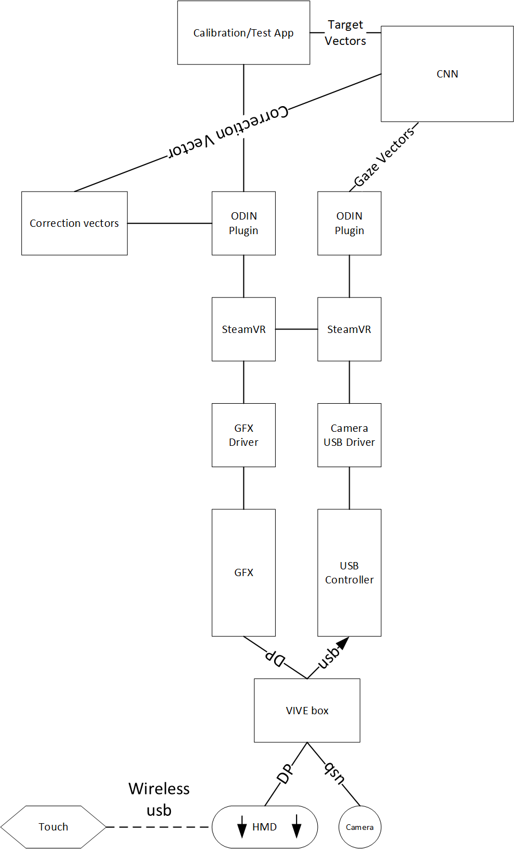
Block Diagram
Design Flow of Project ODIN II
Notes:
Todd

Slide 6
Gaze Vector
Format
X, Y, Z coordinates on a three dimensional plane
Software Language C#
Successfully written and tested Output Function
Output function takes X, Y, Z coordinates as arguments
Unity command line display
Gaze Vectors then sent to Comparator
Notes:
Todd

Slide 7
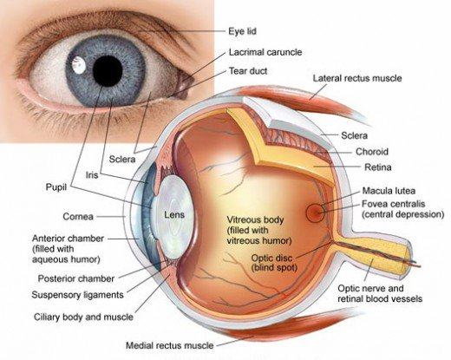
Target Vector
Produced when lens is focused on Target
The lens is composed of transparent, flexible tissue and is located directly behind the iris and the pupil. It is the second part of your eye, after the cornea, that helps to focus light and images on your retina.
Used in determining Correction Vectors
Obtained from Calibration Test Application
Gaze Vector – Target Vector = Correction Vector
Notes:
Todd

Slide 8
Correction Vector
Comparator Function
Takes X, Y, Z coordinates from Gaze Vector as argument
Three dimensional X, Y, Z comparison
Produce Correction Vector
Beyond Deliverables:
Correction vector sent to Unity for Foveated Rendering
Foveated rendering is blurring misaligned eye lens areas
Forcing eye lens to focus on the “clear” area
Notes:
Todd

Slide 9
Touch Controllers
Replace default touch controller trigger events with our own
On corresponding eye/controller use the trigger event to manipulate the field of view
Use the change in 3-dimensional angle and position of the touch controller to change the field of view to the corresponding eye
The right controller controls the right eye and the left controller controls the left eye
Task: Get access to the controller angle and position
Notes:
Bram

Slide 10
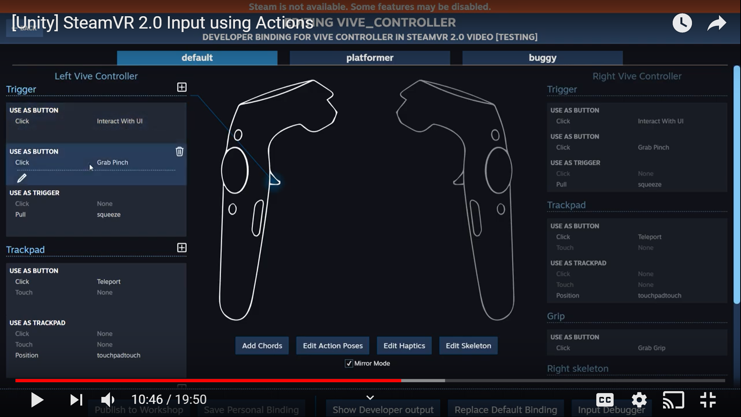
Touch Controllers
Screenshot
Needs to be tested:
Using the binding UI to connect actions to the controller (ex: like a trigger press)
screenshot source: https://www.youtube.com/watch?v=bn8eMxBcI70&t=351s
location data:
for fingers is stored in a class type: SteamVR_Action_Skeleton
for the controller is stored in: SteamVR_Action_Pose
both of these classes contain position and rotation data -- we would need to poll the data in our script
Notes:
Karla

Slide 11
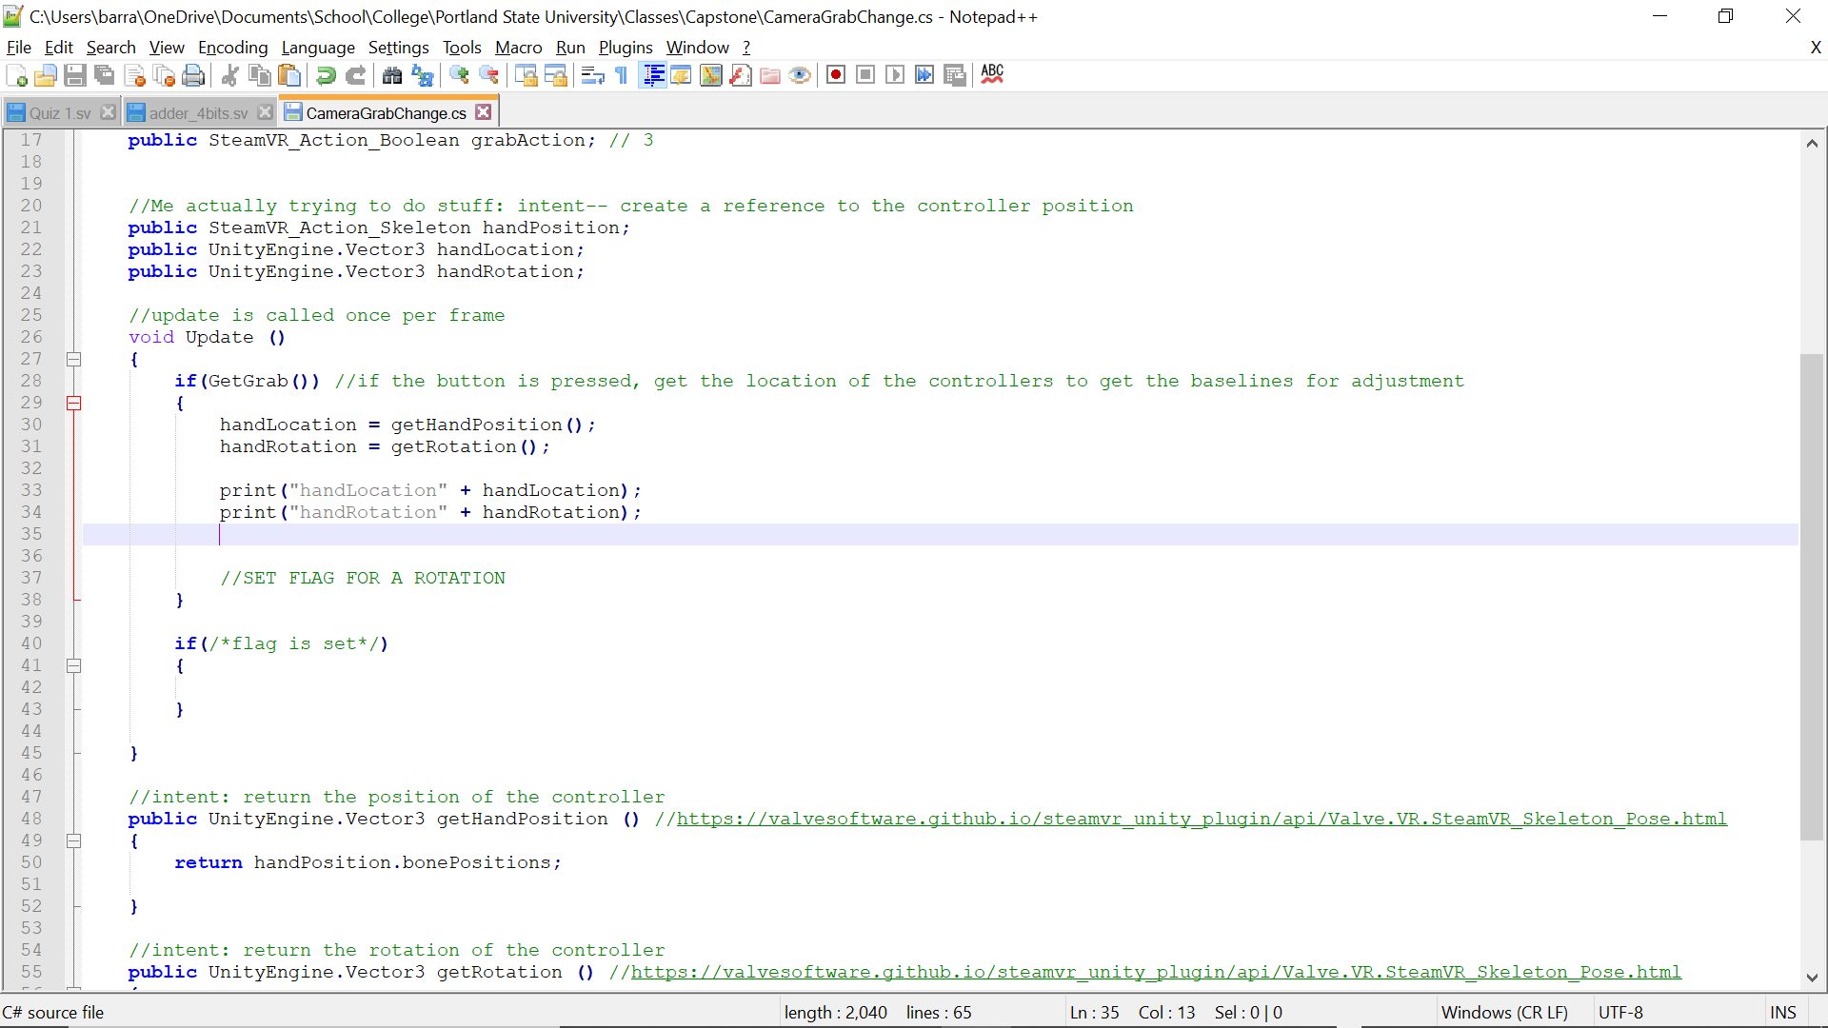
Touch Controllers
Test me!
Notes:
Karla

Slide 12
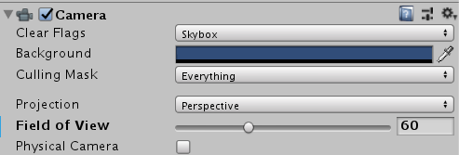
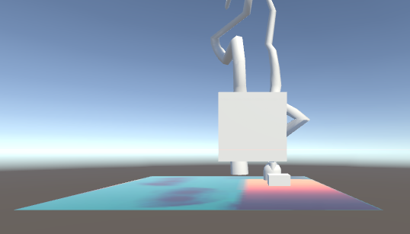
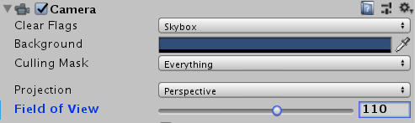
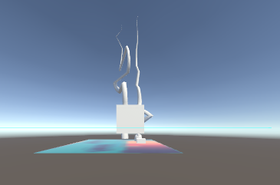
Field of View
a person's normal field of view angle is 110 degrees. When it exceeds 110 degrees, people usually turn their heads to see.
Notes:
Xuening

Slide 13
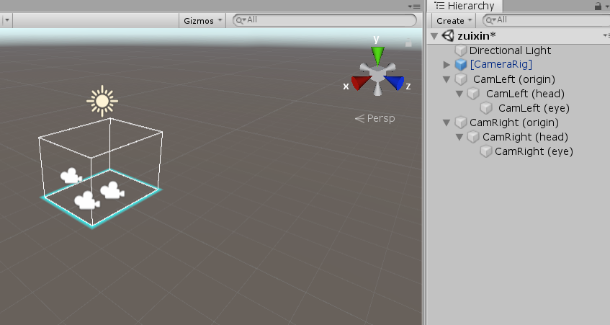
Field of View
Making the left and right eyes display content separately; (Set up Left Camera and Right Camera)
Using corrector vectors and apply them to the Field of View(FOV); (Foveated Rendering）
Notes:
Wenhao

Slide 14
Roadblocks
With us going moving to remote access for life there have been one large roadblock that has halted development, access to the hardware.
Without access to the hardware we are currently stuck and unable to test the methods we have created to pulled the data from the hardware.
Getting quick response to test our ideas and code.
We have to wait for our industry sponsor or his kids.
Notes:
Wenhao

